Slide 1
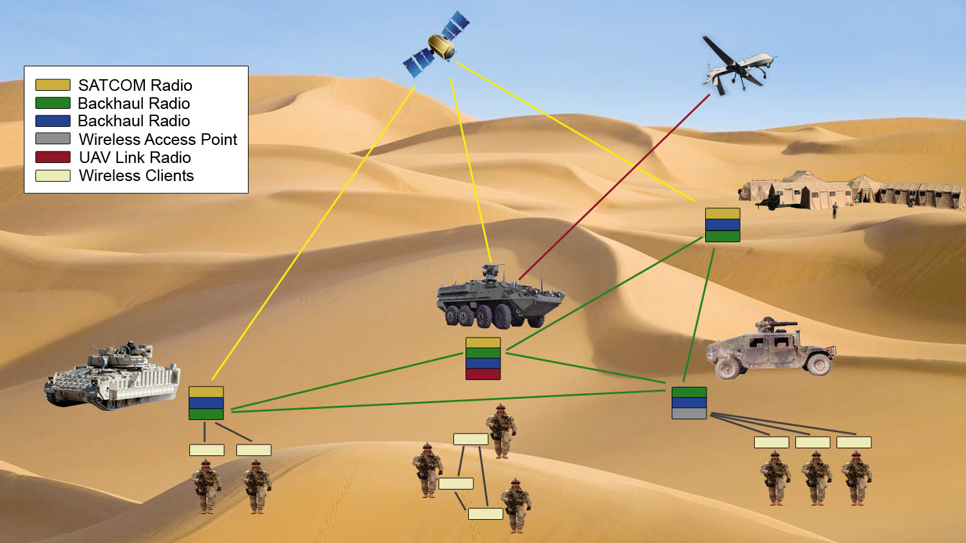
Mobile Ad Hoc Networks Routing
Dr. Muazzam A. Khan

Slide 2
Outline
Introduction
Unicast routing
Multicast routing
Geocast routing
Broadcast Routing
Anycast Routing

Slide 3
Mobile Ad Hoc Networks
Formed by wireless hosts which may be mobile
Without (necessarily) using a pre-existing infrastructure
Routes between nodes may potentially contain multiple hops

Slide 4
Mobile Ad Hoc Networks
May need to traverse multiple links to reach a destination

Slide 5
Mobile Ad Hoc Networks (MANET)
Mobility causes route changes

Slide 6
Why Ad Hoc Networks ?
Ease of deployment
Speed of deployment
Decreased dependence on infrastructure

Slide 7
Many Variations
Fully Symmetric Environment
  all nodes have identical capabilities and responsibilities
Asymmetric Capabilities
  transmission ranges and radios may differ
  battery life at different nodes may differ
  processing capacity may be different at different nodes
  speed of movement
Asymmetric Responsibilities
  only some nodes may route packets
  some nodes may act as leaders of nearby nodes (e.g., cluster head)

Slide 8
Many Variations
Traffic characteristics may differ in different ad hoc networks
  bit rate
  time constraints
  reliability requirements
  unicast / multicast / geocast
  host-based addressing / content-based addressing / capability-based addressing
May co-exist (and co-operate) with an infrastructure-based network

Slide 9
Many Variations
Mobility characteristics
  Speed
  Predictability
    direction of movement
    pattern of movement
  Uniformity (or lack of) of mobility characteristics among different nodes

Slide 10
Challenges
Limited wireless transmission range
Broadcast nature of the wireless medium
  Hidden terminal problem
  Packet losses due to transmission errors
Mobility-induced route changes
Mobility-induced packet losses
Battery constraints
Potentially frequent network partitions
Ease of snooping on wireless transmissions (security hazard)

Slide 11
Research on Mobile Ad Hoc Networks
Variations in capabilities & responsibilities
X
Variations in traffic characteristics, mobility models, etc.
X
Performance criteria (e.g., optimize throughput, reduce energy consumption)
+
Increased research funding
=
Significant research activity

Slide 12
Why is Routing in MANET different ?
Host mobility
  link failure/repair due to mobility may have different characteristics than those due to other causes
Rate of link failure/repair may be high when nodes move fast
New performance criteria may be used
  route stability despite mobility
  energy consumption

Slide 13
Unicast Routing Protocols
Many protocols have been proposed
Some have been invented specifically for MANET
Others are adapted from previously proposed protocols for wired networks
No single protocol works well in all environments
  some attempts made to develop adaptive protocols

Slide 14
Routing Protocols
Proactive protocols
  Determine routes independent of traffic pattern
  Traditional link-state and distance-vector routing protocols are proactive
Reactive protocols
  Maintain routes only if needed
Hybrid protocols

Slide 15
Trade-Off
Latency of route discovery
  Proactive protocols may have lower latency since routes are maintained at all times
  Reactive protocols may have higher latency because a route from X to Y will be found only when X attempts to send to Y
Overhead of route discovery/maintenance
  Reactive protocols may have lower overhead since routes are determined only if needed
  Proactive protocols can (but not necessarily) result in higher overhead due to continuous route updating
Which approach achieves a better trade-off depends on the traffic and mobility patterns

Slide 16
Overview of Unicast Routing Protocols

Slide 17
Flooding for Data Delivery
Sender S broadcasts data packet P to all its neighbors
Each node receiving P forwards P to its neighbors
Sequence numbers used to avoid the possibility of forwarding the same packet more than once
Packet P reaches destination D provided that D is reachable from sender S
Node D does not forward the packet

Slide 18

Flooding for Data Delivery
Y
Z
S
E
F
B
C
M
L
J
A
G
H
D
K
I
N
Represents a node that has received packet P
Represents that connected nodes are within each
other’s transmission range

Slide 19
Flooding for Data Delivery
Y
Broadcast transmission
Z
S
E
F
B
C
M
L
J
A
G
H
D
K
I
N
Represents a node that receives packet P for
the first time
Represents transmission of packet P

Slide 20
Flooding for Data Delivery
Y
Z
S
E
F
B
C
M
L
J
A
G
H
D
K
I
N
Node H receives packet P from two neighbors:
potential for collision

Slide 21
Flooding for Data Delivery
Y
Z
S
E
F
B
C
M
L
J
A
G
H
D
K
I
N
Node C receives packet P from G and H, but does not forward
it again, because node C has already forwarded packet P once

Slide 22
Flooding for Data Delivery
Y
Z
S
E
F
B
C
M
L
J
A
G
H
D
K
I
N
Nodes J and K both broadcast packet P to node D
Since nodes J and K are hidden from each other, their
transmissions may collide
=> Packet P may not be delivered to node D at all,
despite the use of flooding

Slide 23
Flooding for Data Delivery
Y
Z
S
E
F
B
C
M
L
J
A
G
H
D
K
I
N
Node D does not forward packet P, because node D
is the intended destination of packet P

Slide 24
Flooding for Data Delivery
Y
Z
S
E
F
B
C
M
L
J
A
G
H
D
K
I
N
Flooding completed
Nodes unreachable from S do not receive packet P (e.g., node Z)
Nodes for which all paths from S go through the destination D
also do not receive packet P (example: node N)

Slide 25
Flooding for Data Delivery
Y
Z
S
E
F
B
C
M
L
J
A
G
H
D
K
I
N
Flooding may deliver packets to too many nodes
(in the worst case, all nodes reachable from sender
may receive the packet)

Slide 26
Flooding for Data Delivery: Advantages
Simplicity
May be more efficient than other protocols when rate of information transmission is low enough that the overhead of explicit route discovery/maintenance incurred by other protocols is relatively higher
  this scenario may occur, for instance, when nodes transmit small data packets relatively infrequently, and many topology changes occur between consecutive packet transmissions
Potentially higher reliability of data delivery
  Because packets may be delivered to the destination on multiple paths

Slide 27
Flooding for Data Delivery: Disadvantages
Potentially, very high overhead
  Data packets may be delivered to too many nodes who do not need to receive them
Potentially lower reliability of data delivery
  Flooding uses broadcasting -- hard to implement reliable broadcast delivery without significantly increasing overhead
  In our example, nodes J and K may transmit to node D simultaneously, resulting in loss of the packet

Slide 28
Flooding of Control Packets
Many protocols perform (potentially limited) flooding of control packets, instead of data packets
The control packets are used to discover routes
Discovered routes are subsequently used to send data packet(s)
Overhead of control packet flooding is amortized over data packets transmitted between consecutive control packet floods

Slide 29
Dynamic Source Routing (DSR)
When node S wants to send a packet to node D, but does not know a route to D, node S initiates a route discovery
Source node S floods Route Request (RREQ)
Each node appends own identifier when forwarding RREQ

Slide 30
Route Discovery in DSR
Y
Z
S
E
F
B
C
M
L
J
A
G
H
D
K
I
N
Represents a node that has received RREQ for D from S

Slide 31
Route Discovery in DSR
Y
Broadcast transmission
[S]
Z
S
E
F
B
C
M
L
J
A
G
H
D
K
I
N
Represents transmission of RREQ
[X,Y] Represents list of identifiers appended to RREQ

Slide 32
Route Discovery in DSR
Y
Z
S
E
[S,E]
F
B
C
M
L
J
A
[S,C]
G
H
D
K
I
N
Node H receives packet RREQ from two neighbors:
potential for collision

Slide 33
Route Discovery in DSR
Y
Z
S
E
F
[S,E,F]
B
C
M
L
J
A
G
H
D
K
I
[S,C,G]
N
Node C receives RREQ from G and H, but does not forward
it again, because node C has already forwarded RREQ once

Slide 34
Route Discovery in DSR
Y
Z
S
E
F
[S,E,F,J]
B
C
M
L
J
A
G
H
D
K
I
[S,C,G,K]
N
Nodes J and K both broadcast RREQ to node D
Since nodes J and K are hidden from each other, their
transmissions may collide

Slide 35
Route Discovery in DSR
Y
Z
S
E
F
[S,E,F,J,M]
B
C
M
L
J
A
G
H
D
K
I
N
Node D does not forward RREQ, because node D
is the intended target of the route discovery

Slide 36
Route Discovery in DSR
Destination D on receiving the first RREQ, sends a Route Reply (RREP)
RREP is sent on a route obtained by reversing the route appended to received RREQ
RREP includes the route from S to D on which RREQ was received by node D

Slide 37
Route Reply in DSR
Y
Z
S
E
RREP [S,E,F,J,D]
F
B
C
M
L
J
A
G
H
D
K
I
N
Represents RREP control message

Slide 38
Route Reply in DSR
Route Reply can be sent by reversing the route in Route Request (RREQ) only if links are guaranteed to be bi-directional
  To ensure this, RREQ should be forwarded only if it received on a link that is known to be bi-directional
If unidirectional (asymmetric) links are allowed, then RREP may need a route discovery for S from node D
  Unless node D already knows a route to node S
  If a route discovery is initiated by D for a route to S, then the Route Reply is piggybacked on the Route Request from D.
If IEEE 802.11 MAC is used to send data, then links have to be bi-directional (since Ack is used)

Slide 39
Dynamic Source Routing (DSR)
Node S on receiving RREP, caches the route included in the RREP
When node S sends a data packet to D, the entire route is included in the packet header
  hence the name source routing
Intermediate nodes use the source route included in a packet to determine to whom a packet should be forwarded

Slide 40
Data Delivery in DSR
Y
DATA [S,E,F,J,D]
Z
S
E
F
B
C
M
L
J
A
G
H
D
K
I
N
Packet header size grows with route length

Slide 41
When to Perform a Route Discovery
When node S wants to send data to node D, but does not know a valid route node D

Slide 42
DSR Optimization: Route Caching
Each node caches a new route it learns by any means
When node S finds route [S,E,F,J,D] to node D, node S also learns route [S,E,F] to node F
When node K receives Route Request [S,C,G] destined for node, node K learns route [K,G,C,S] to node S
When node F forwards Route Reply RREP [S,E,F,J,D], node F learns route [F,J,D] to node D
When node E forwards Data [S,E,F,J,D] it learns route [E,F,J,D] to node D
A node may also learn a route when it overhears Data packets

Slide 43
Use of Route Caching
When node S learns that a route to node D is broken, it uses another route from its local cache, if such a route to D exists in its cache. Otherwise, node S initiates route discovery by sending a route request
Node X on receiving a Route Request for some node D can send a Route Reply if node X knows a route to node D
Use of route cache
  can speed up route discovery
  can reduce propagation of route requests

Slide 44
Use of Route Caching
[S,E,F,J,D]
[E,F,J,D]
S
E
[F,J,D],[F,E,S]
F
B
[J,F,E,S]
C
M
L
J
A
[C,S]
G
H
D
[G,C,S]
K
I
N
Z
Represents cached route at a node
(DSR maintains the cached routes in a tree format)

Slide 45
Use of Route Caching:
Can Speed up Route Discovery
[S,E,F,J,D]
[E,F,J,D]
S
E
[F,J,D],[F,E,S]
F
B
[J,F,E,S]
C
M
L
[G,C,S]
J
A
[C,S]
G
H
D
K
I
[K,G,C,S]
N
RREP
RREQ
Z
When node Z sends a route request
for node C, node K sends back a route
reply [Z,K,G,C] to node Z using a locally
cached route

Slide 46
Use of Route Caching:
Can Reduce Propagation of Route Requests
[S,E,F,J,D]
Y
[E,F,J,D]
S
E
[F,J,D],[F,E,S]
F
B
[J,F,E,S]
C
M
L
[G,C,S]
J
A
[C,S]
G
H
D
K
I
[K,G,C,S]
N
RREP
RREQ
Z
Assume that there is no link between D and Z.
Route Reply (RREP) from node K limits flooding of RREQ.

Slide 47
Route Error (RERR)
Y
RERR [J-D]
Z
S
E
F
B
C
M
L
J
A
G
H
D
K
I
N
J sends a route error to S along route J-F-E-S when its attempt to forward the data packet S (with route SEFJD) on J-D fails
Nodes hearing RERR (Route Error) update their route cache to remove link J-D

Slide 48
Route Caching: Beware!
Stale caches can adversely affect performance
With passage of time and host mobility, cached routes may become invalid
A sender host may try several stale routes (obtained from local cache, or replied from cache by other nodes), before finding a good route

Slide 49
Dynamic Source Routing:
Advantages
Routes maintained only between nodes who need to communicate
  reduces overhead of route maintenance
Route caching can further reduce route discovery overhead
A single route discovery may yield many routes to the destination, due to intermediate nodes replying from local caches

Slide 50
Disadvantages
Packet header size grows with route length due to source routing
Flood of route requests may potentially reach all nodes in the network
Care must be taken to avoid collisions between route requests propagated by neighboring nodes
  insertion of random delays before forwarding RREQ
Increased contention if too many route replies come back due to nodes replying using their local cache
  Route Reply Storm problem
  Reply storm may be eased by preventing a node from sending RREP if it hears another RREP with a shorter route

Slide 51
Disadvantages
An intermediate node may send Route Reply using a stale cached route, thus polluting other caches
This problem can be eased if some mechanism to purge (potentially) invalid cached routes is incorporated.
Some proposals for cache invalidation,
  Static timeouts
  Adaptive timeouts based on link stability

Slide 52
Flooding of Control Packets
How to reduce the scope of the route request flood ?
  LAR
  Query localization
How to reduce redundant broadcasts ?
  The Broadcast Storm Problem

